Slide 1
CS Task 2: SE Process
Project pink

Slide 2
Plan driven vs. agile
Process Decision

Slide 3
Key facts
Legal restriction
Data security
Project Character
changing health system
unclear requirements
Team Structure

Slide 4
Software Engineering
Project Process

Slide 5
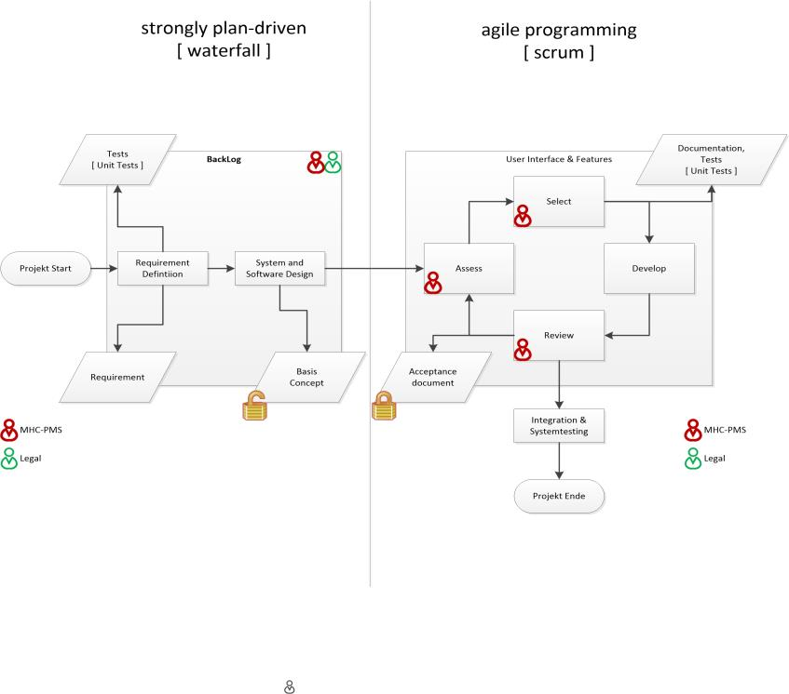
Process

Slide 6
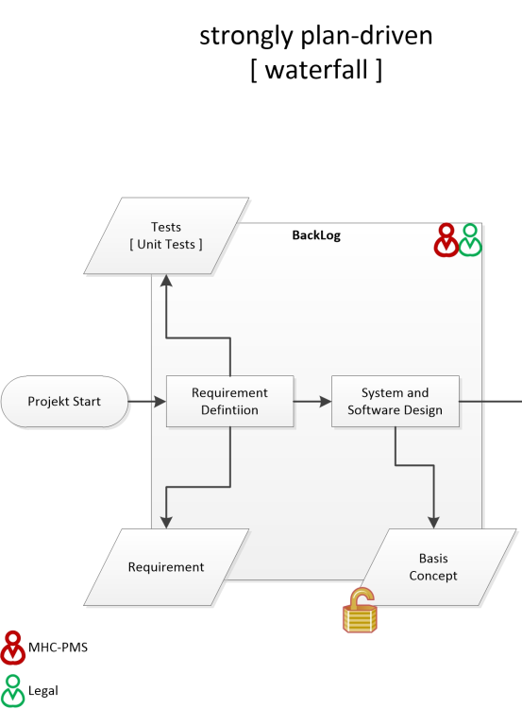

Slide 7
